Slide 1

BERT - Experiments

Slide 2
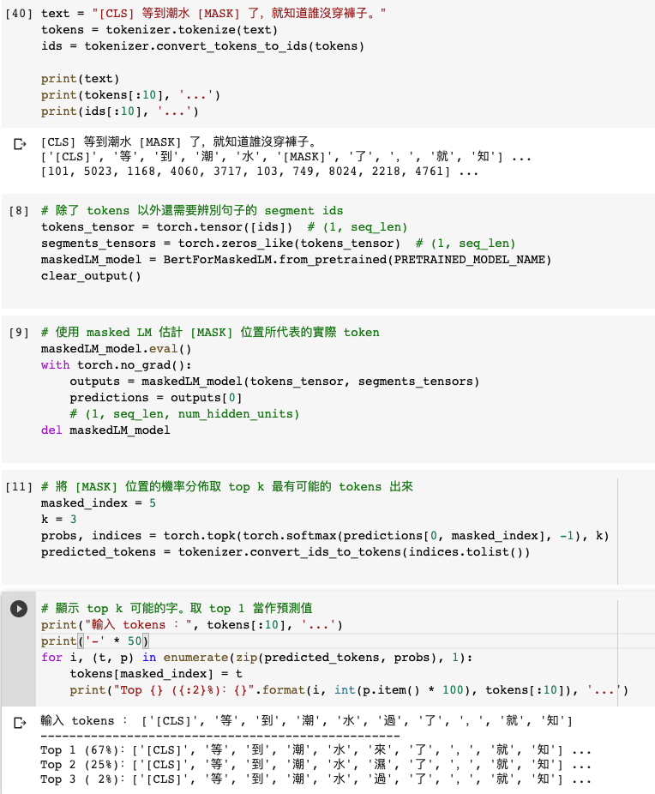
Masked Language Model (MLM)

Slide 3
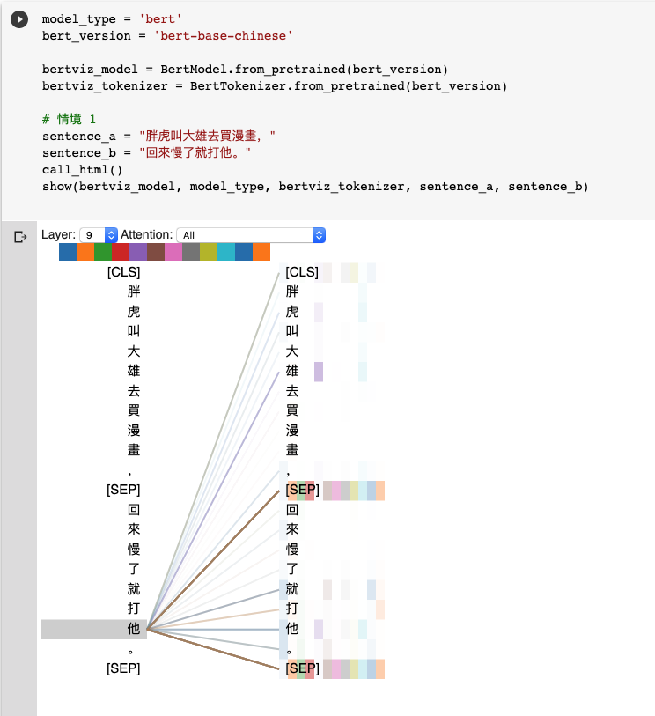
Natural Language Inference (NLI)
Attention Visualization

Slide 4
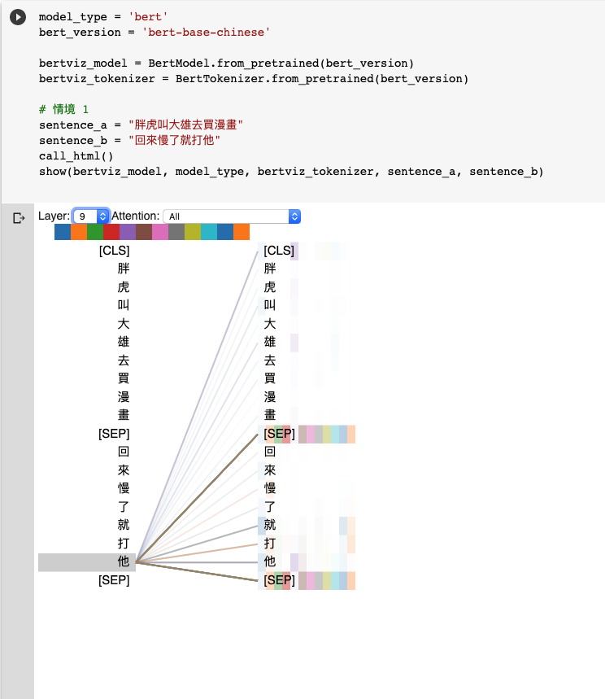
Natural Language Inference (NLI)
Attention Visualization

Slide 5
Source Code Analysis

Slide 6
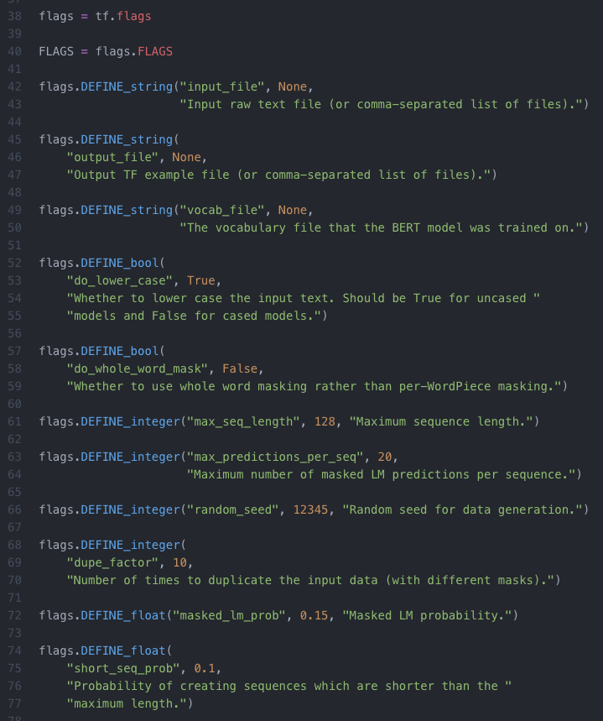
input_file
output_file
vocab_file：指定字典路徑（Google提供, Tokenization 會用到）
do_lower_case
max_seq_length：每一條訓練數據（兩句話）相加後的最大長度限制 (128)
max_predictions_per_seq：每一條訓練數據mask的最大數量
random_seed：隨機種子 (12345)
dupe_factor：對文檔多次重複隨機產生訓練集，隨機的次數 (10)
masked_lm_prob：訓練數據產生mask的概率 (0.15)
max_predictions_per_seq*masked_lm_prob數量的mask
short_seq_prob：為了縮小預訓練和微調過程的差距，從而概率產生小於max_seq_length的訓練數據

Slide 7
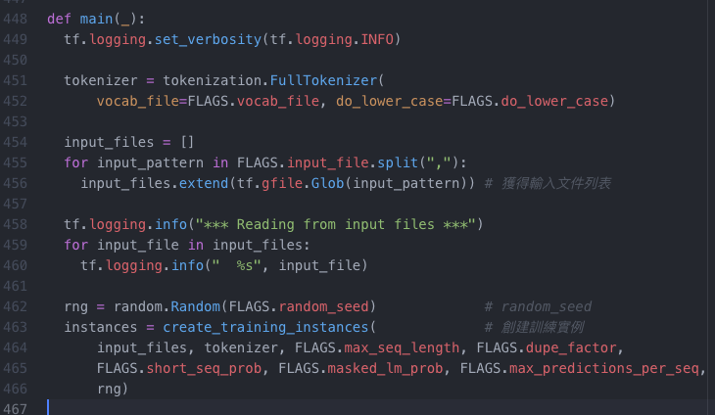
預訓練
核心模型構建
訓練
create_pretraining_data.py
modeling.py
run_pretraining.py
def create_training_instances
創建訓練實例
Devlin, Jacob, et al. "Bert: Pre-training of deep bidirectional transformers for language understanding." arXiv preprint arXiv:1810.04805 (2018).

Slide 8
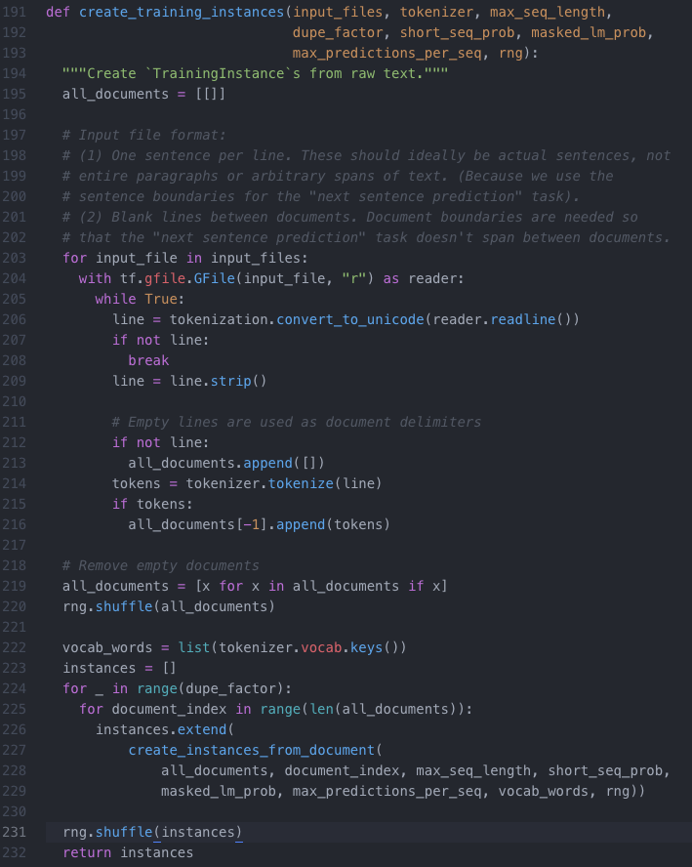
Input File Format Restriction
Pre-training
Tokenization
Tokenization

Slide 9
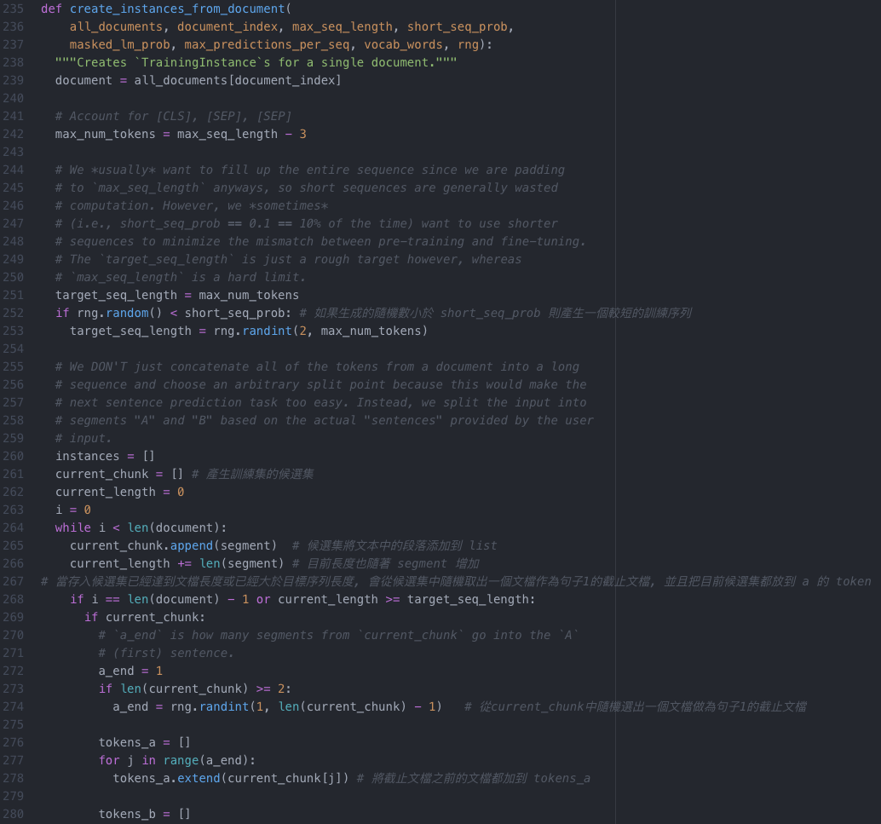
[CLS], [SEP], [SEP]
Pre-training
Next Sentence Prediction (NSP)
short_seq_prob
current_chunk
current_chunk
token
current_chunk
token

Slide 10
ELMo, BERT, GPT

Slide 11
Word Embedding
One-Hot-Encoding
Bag-of-Words (BoW)
一詞多義
1 type 1 embedding
1 type 固定數量的 embedding
每個 token 不同的embedding
Contextualized Word Embedding

Slide 12
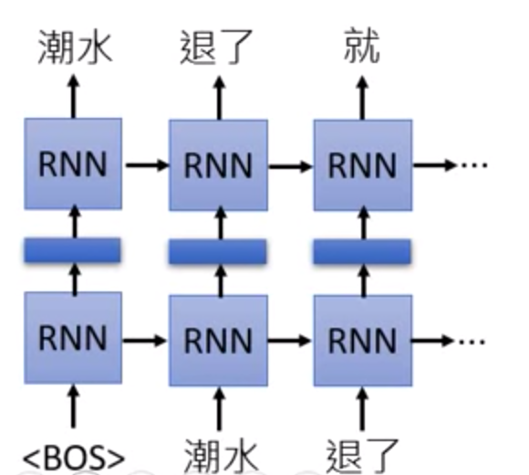
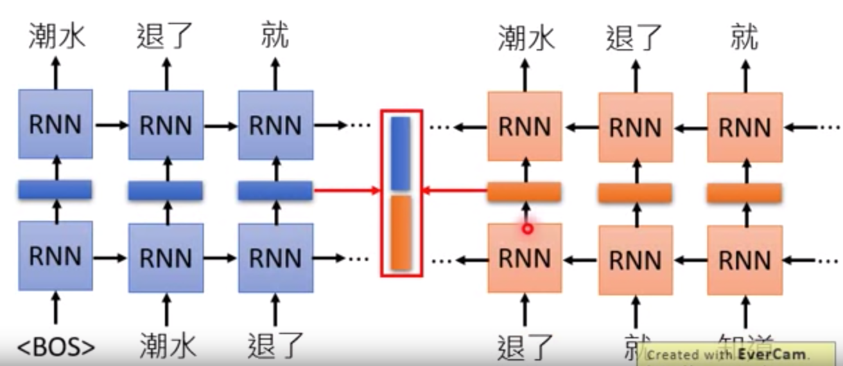
Embedding from Language Model (ELMo)
RNN-based Language Model: 蒐集未標註的句子, 再由RNN訓練
只考慮到左側上文

Slide 13
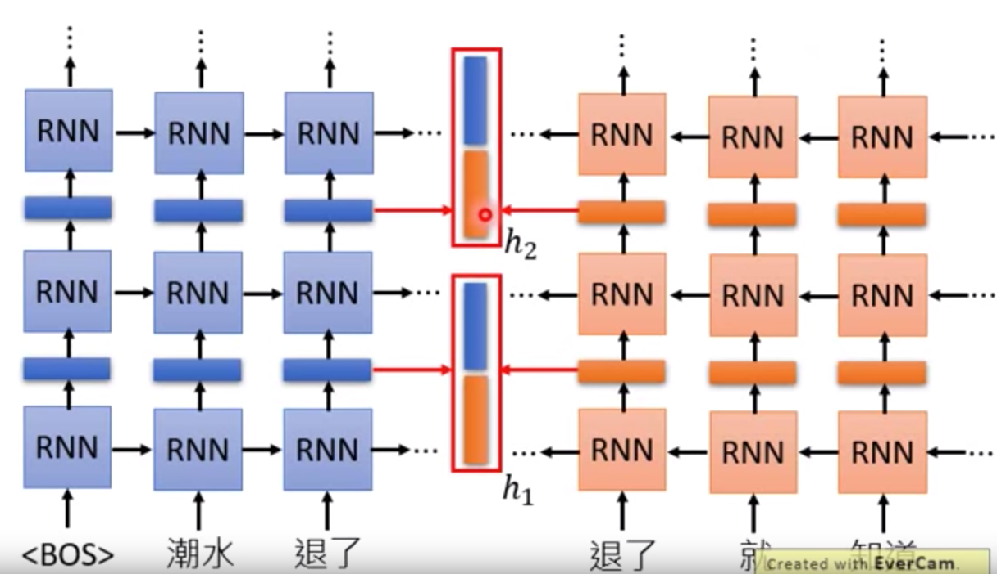
Embedding from Language Model (ELMo)

Slide 14
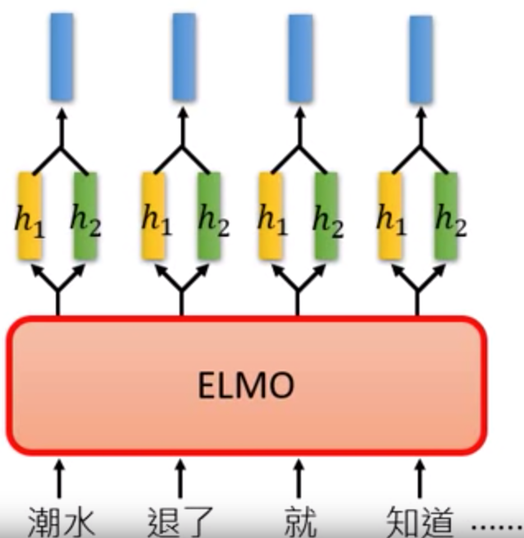
Embedding from Language Model (ELMo)

Slide 15
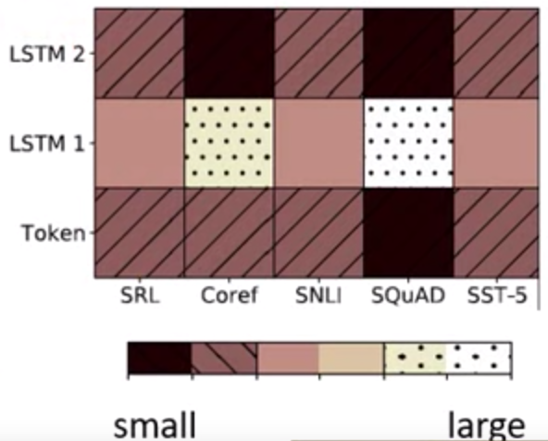
Embedding from Language Model (ELMo)

Slide 16
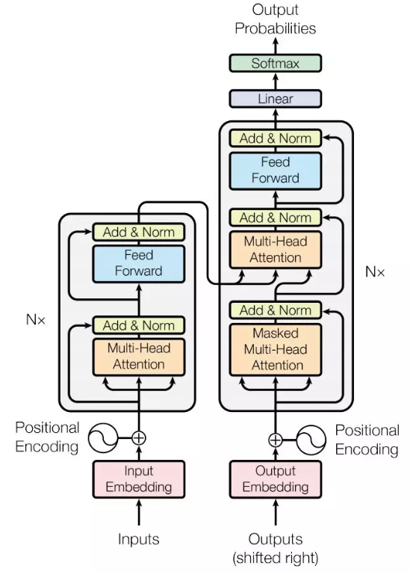
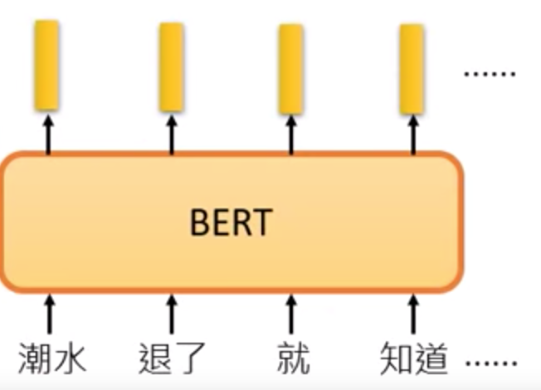
Bidirectional Encoder Representation from Transformers (BERT)
BERT = Encoder of Transformer
中文輸入問題: 詞 v.s.字
Devlin, Jacob, et al. "Bert: Pre-training of deep bidirectional transformers for language understanding." arXiv preprint arXiv:1810.04805 (2018).

Slide 17
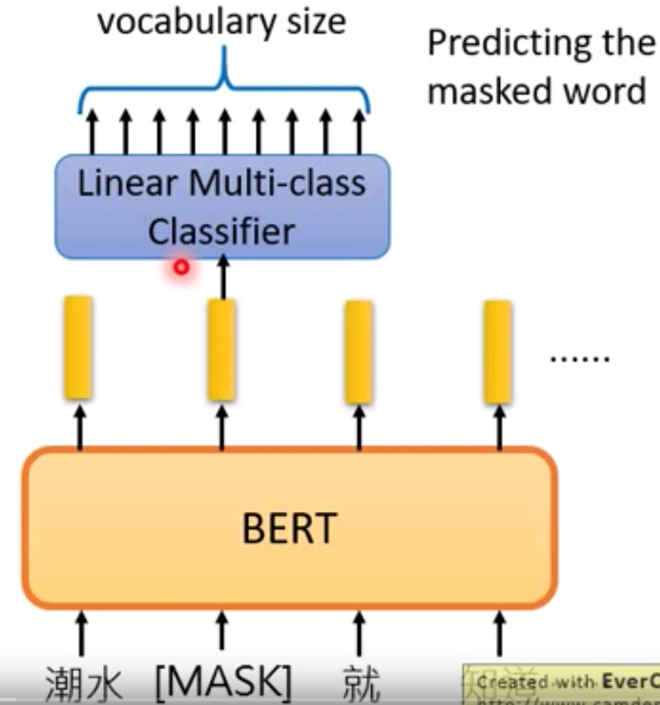
Bidirectional Encoder Representation from Transformers (BERT)
Pre-training
Masked Language Model (MLM)
Devlin, Jacob, et al. "Bert: Pre-training of deep bidirectional transformers for language understanding." arXiv preprint arXiv:1810.04805 (2018).

Slide 18
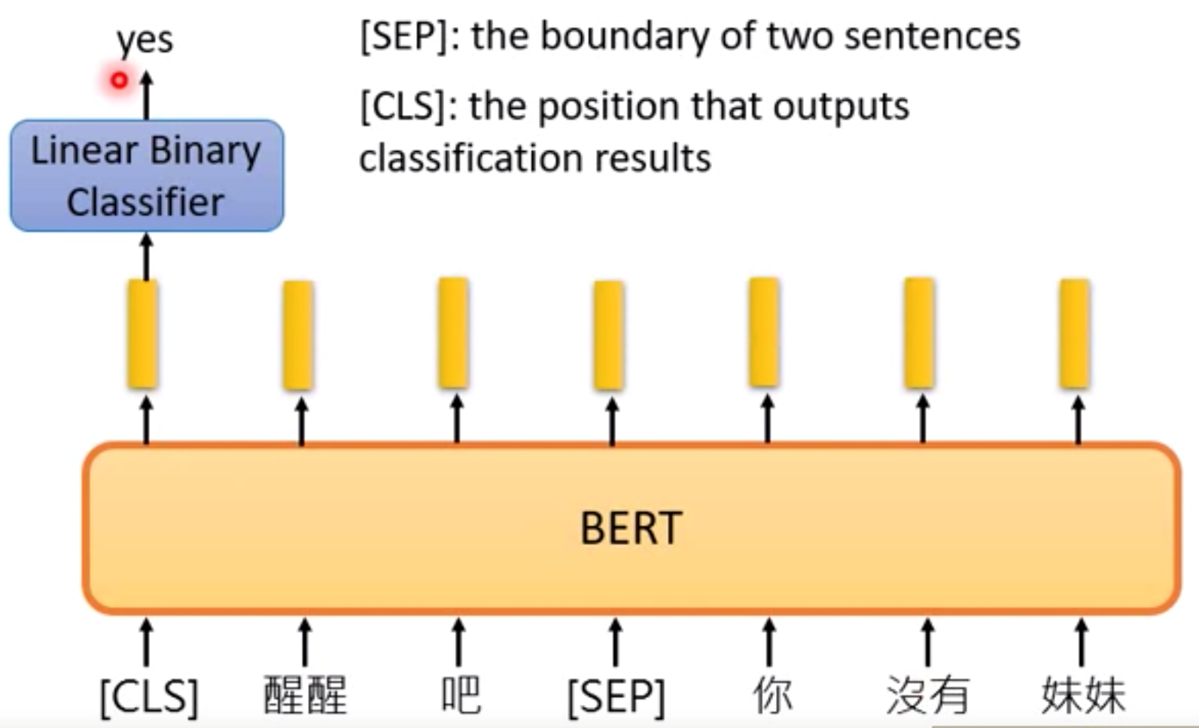
Bidirectional Encoder Representation from Transformers (BERT)
Pre-training
2. Next Sentence Prediction (NSP)
[SEP]: 句子間的分界
[CLS]: 放在句子開頭token, 告訴Encoder要做 Classification
Devlin, Jacob, et al. "Bert: Pre-training of deep bidirectional transformers for language understanding." arXiv preprint arXiv:1810.04805 (2018).

Slide 19
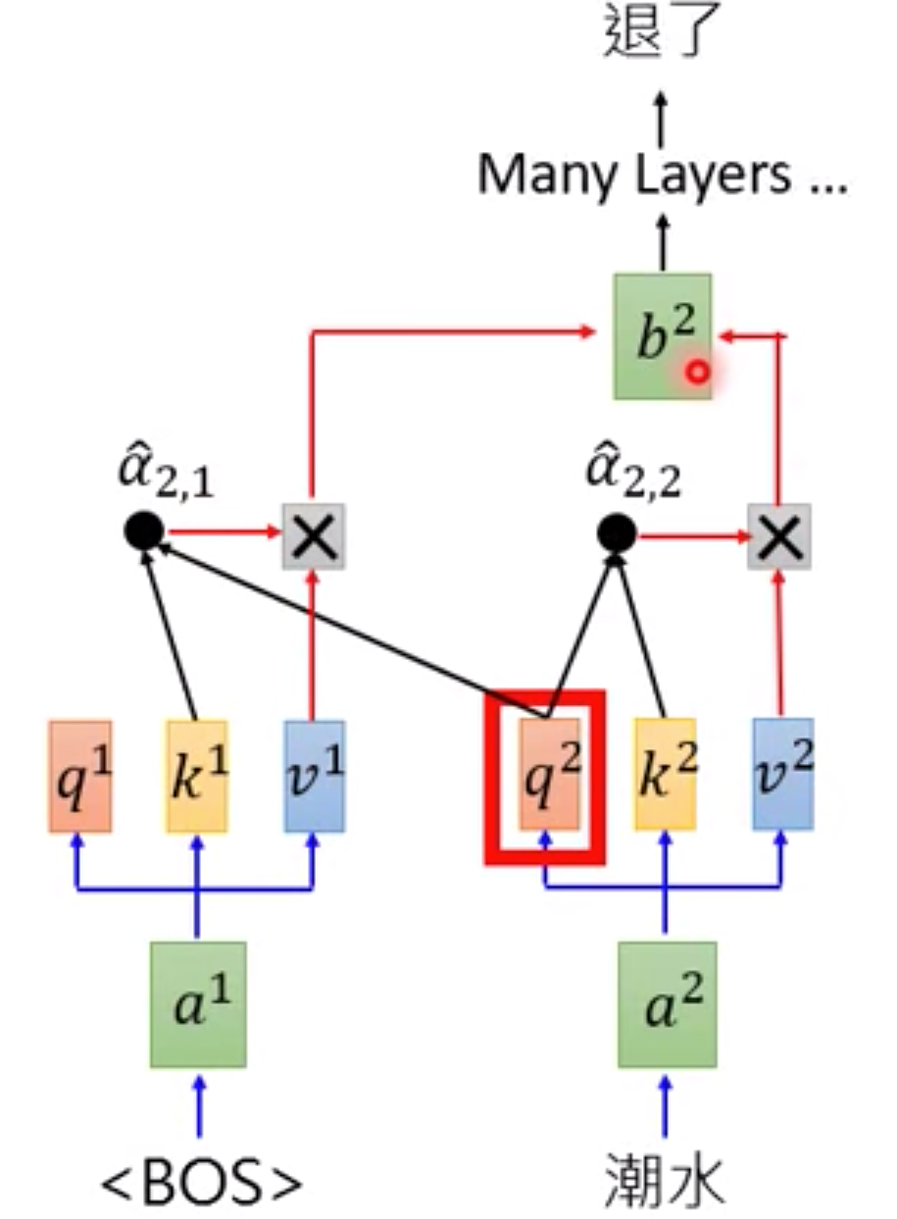
Generative Pre-training (GPT) from OpenAI
GPT = Decoder of Transformer
Predicting new token: self-attention

Slide 20
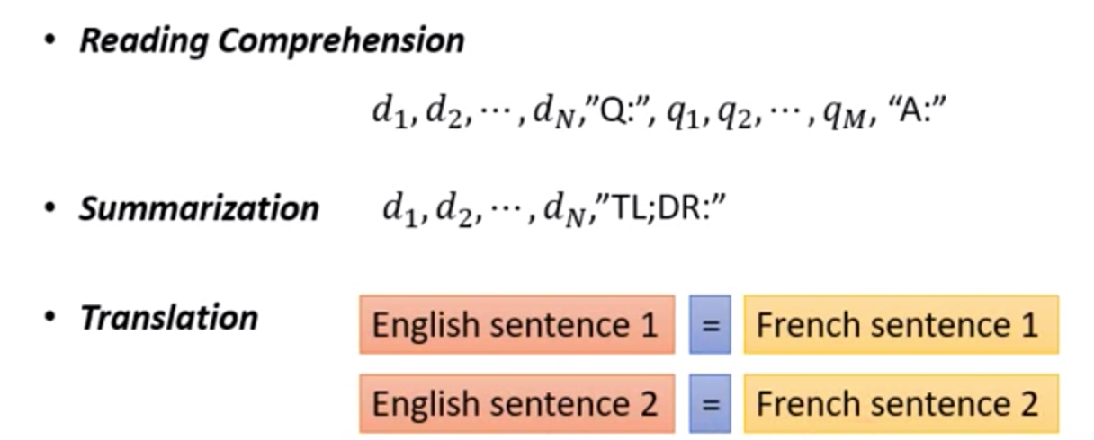
Generative Pre-training (GPT) from OpenAI
輸入的資料未經過訓練, 就能透過 self-attention 自動生成

Slide 21
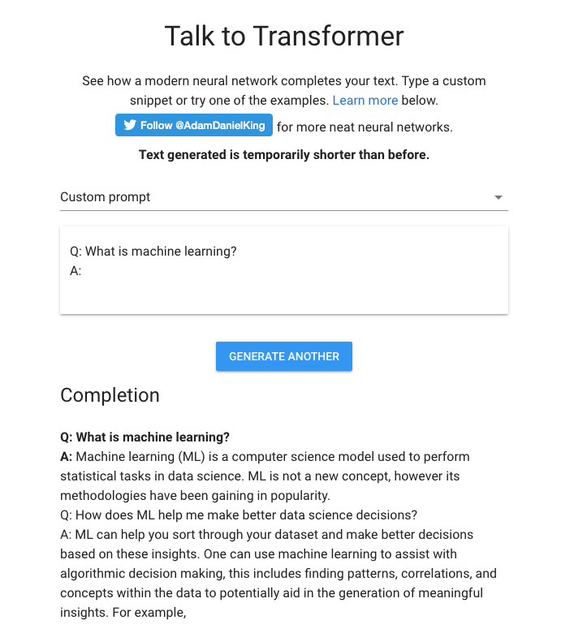
Generative Pre-training (GPT) from OpenAI

Slide 22
Seq2Seq with Attention

Slide 23
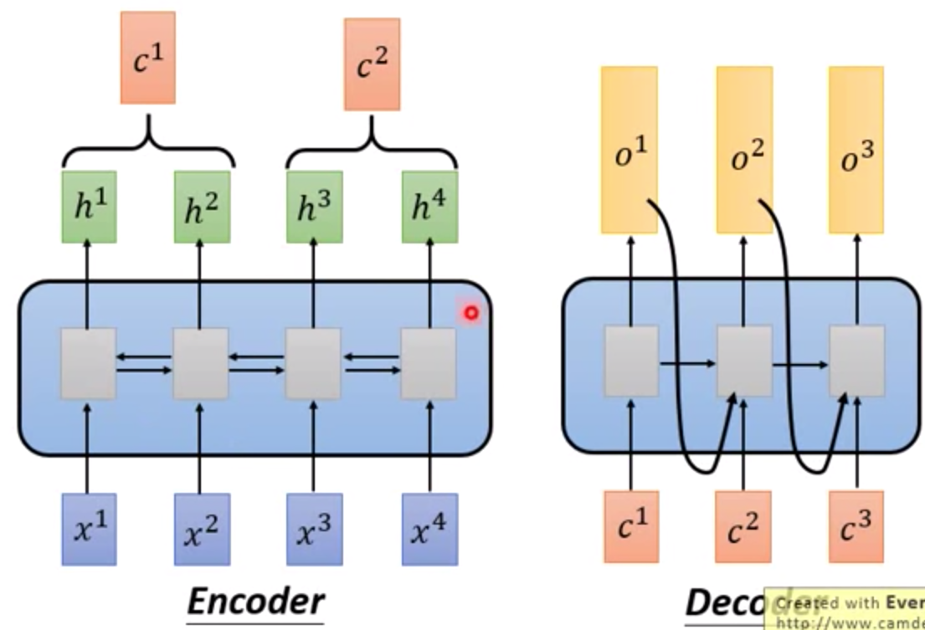
Seq2Seq

Slide 24
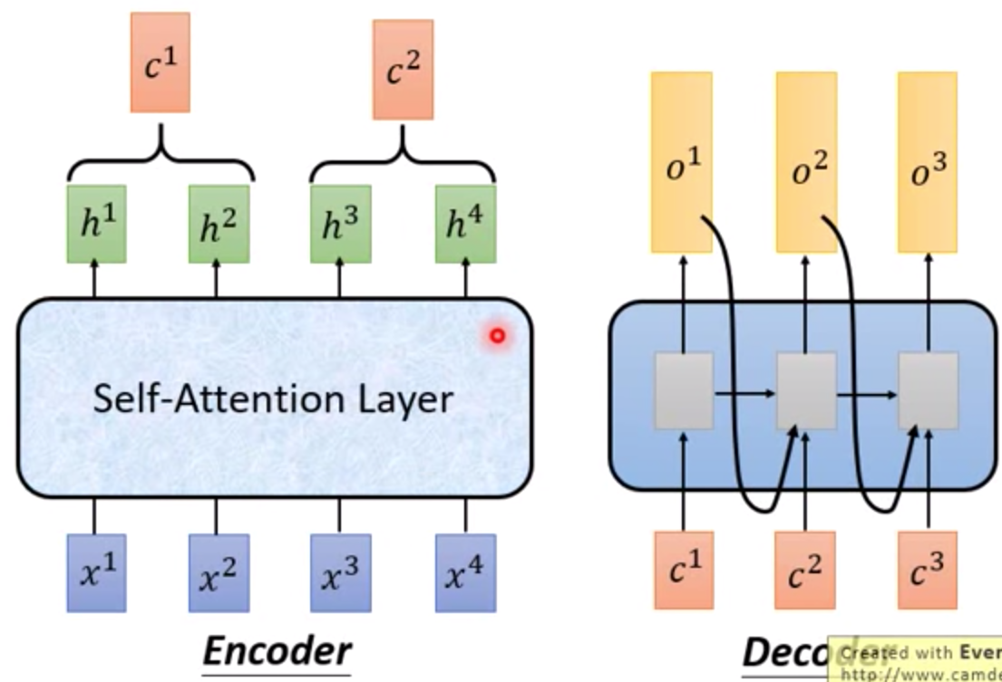
Seq2Seq with Attention

Slide 25
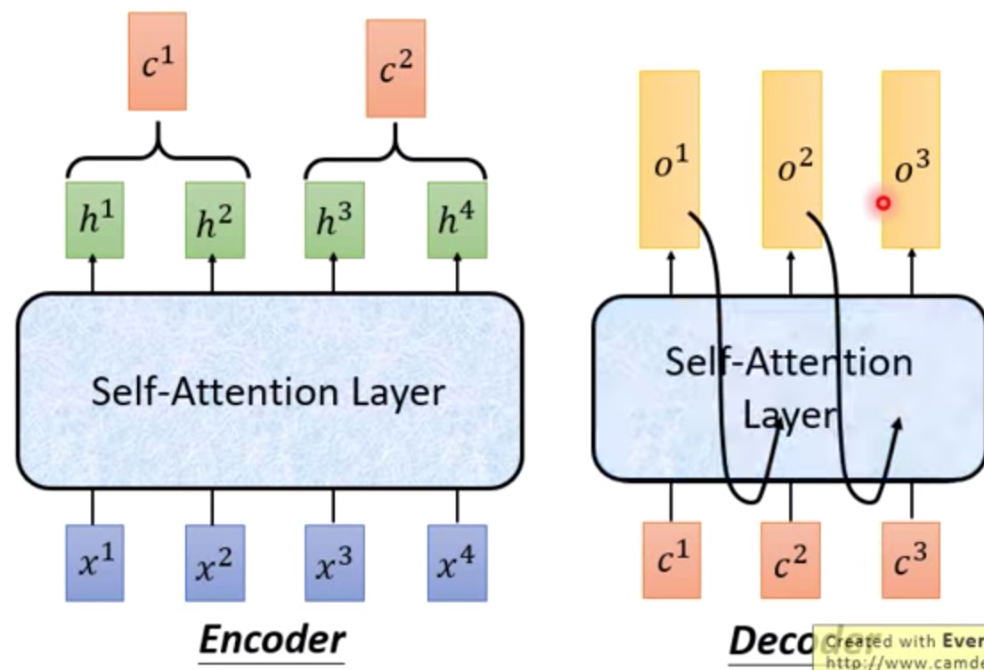
Seq2Seq with Attention

Slide 26

Seq2Seq with Attention
Visualization

Slide 27
Activation Function

Slide 28
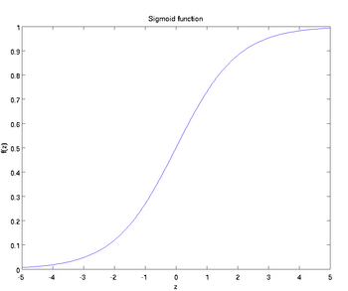
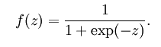
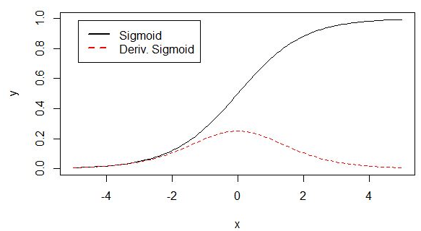
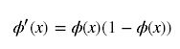
Activation Function
1. Sigmoid

Slide 29
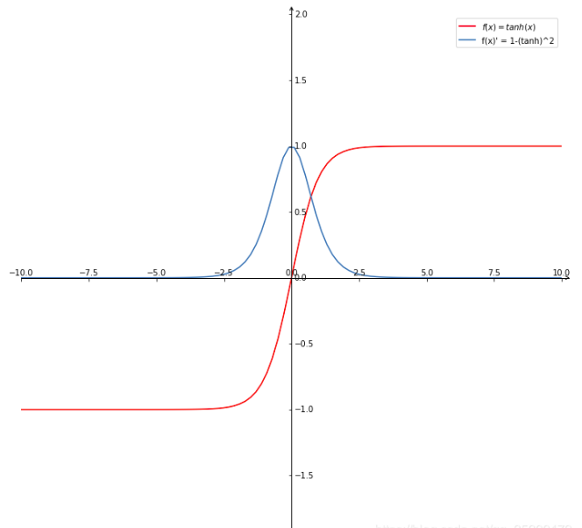
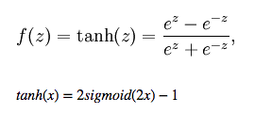
Activation Function
2. Hyperbolic Tangent Function

Slide 30
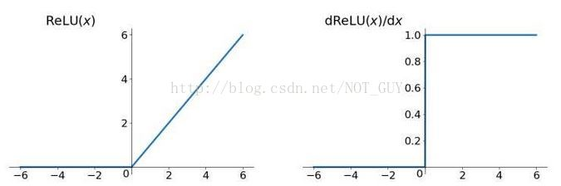
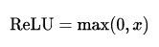
Activation Function
3. ReLU (Rectified Linear Unit)
Dead ReLU Problem -> LeakyReLU

Slide 31
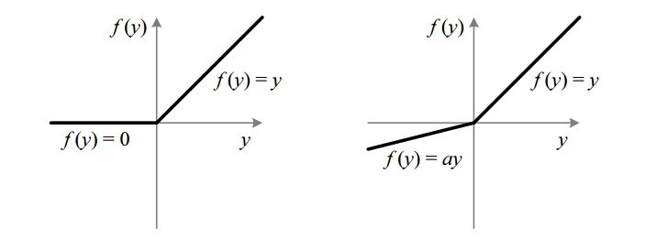
Activation Function
4. Leaky ReLU
When a = 0, it becomes ReLU.

Slide 32
Activation Function
5. SELU

Slide 33
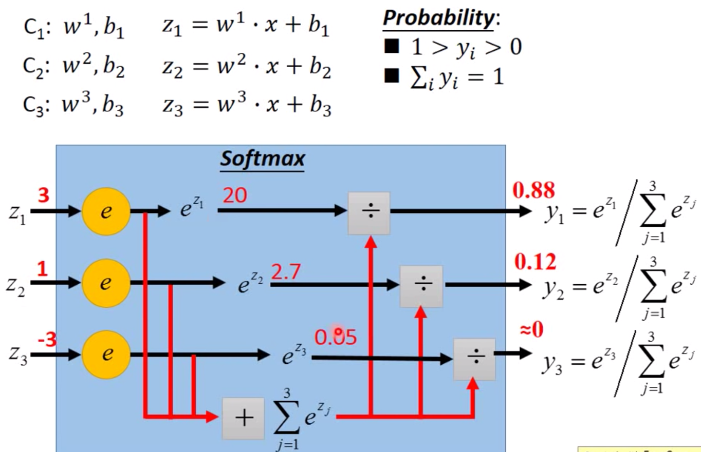
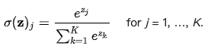
Activation Function
6. Softmax
Softmax(x) = Softmax(x+c)

Slide 34
Residual Connection

Slide 35
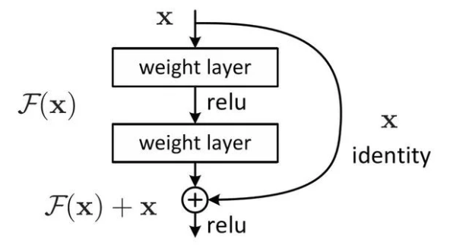
Residual-Connection (from ResNet)
G(x) = F(x) + x

Slide 36
WordPiece

Slide 37
Byte-Pair Encoding (BPE)
Word -> Pieces
"loved","loving","loves"
"lov","ed","ing","es"
Devlin, Jacob, et al. "Bert: Pre-training of deep bidirectional transformers for language understanding." arXiv preprint arXiv:1810.04805 (2018).

Slide 38
Source Code
(Data Preprocessing)
Devlin, Jacob, et al. "Bert: Pre-training of deep bidirectional transformers for language understanding." arXiv preprint arXiv:1810.04805 (2018).

Slide 39
num_train_steps (epochs)
warm_up_steps
https://github.com/the-Quert/iNLPfun/blob/master/BERT/run_classifier.py - L848-L856
MRPC（Microsoft Research Paraphrase Corpus)
Devlin, Jacob, et al. "Bert: Pre-training of deep bidirectional transformers for language understanding." arXiv preprint arXiv:1810.04805 (2018).

Slide 40
file_based_convert_example_to_features
https://github.com/the-Quert/iNLPfun/blob/master/BERT/run_classifier.py - L484-L513
Devlin, Jacob, et al. "Bert: Pre-training of deep bidirectional transformers for language understanding." arXiv preprint arXiv:1810.04805 (2018).

Slide 41
convert_single_example (tokens for different sequence)
https://github.com/the-Quert/iNLPfun/blob/master/BERT/run_classifier.py - L377-L398
Devlin, Jacob, et al. "Bert: Pre-training of deep bidirectional transformers for language understanding." arXiv preprint arXiv:1810.04805 (2018).

Slide 42
tokenize
https://github.com/the-Quert/iNLPfun/blob/master/BERT/tokenization.py - L170-L178
Devlin, Jacob, et al. "Bert: Pre-training of deep bidirectional transformers for language understanding." arXiv preprint arXiv:1810.04805 (2018).

Slide 43
convert_single_example (tokens for different sequence)
https://github.com/the-Quert/iNLPfun/blob/master/BERT/run_classifier.py - L399-L407
Devlin, Jacob, et al. "Bert: Pre-training of deep bidirectional transformers for language understanding." arXiv preprint arXiv:1810.04805 (2018).

Slide 44
﻿_truncate_seq_pair
https://github.com/the-Quert/iNLPfun/blob/master/BERT/run_classifier.py - L564-L578
Devlin, Jacob, et al. "Bert: Pre-training of deep bidirectional transformers for language understanding." arXiv preprint arXiv:1810.04805 (2018).

Slide 45
convert_single_example (tokens for different sequence)
https://github.com/the-Quert/iNLPfun/blob/master/BERT/run_classifier.py - L409-L481
[CLS] Sentence_1 [SEP] Sentence_2 [SEP]
[CLS] Sentence_1 [SEP]
Devlin, Jacob, et al. "Bert: Pre-training of deep bidirectional transformers for language understanding." arXiv preprint arXiv:1810.04805 (2018).

Slide 46
create_model
https://github.com/the-Quert/iNLPfun/blob/master/BERT/run_classifier.py - L581-L590
Devlin, Jacob, et al. "Bert: Pre-training of deep bidirectional transformers for language understanding." arXiv preprint arXiv:1810.04805 (2018).

Slide 47
Source Code
(Modeling)
Devlin, Jacob, et al. "Bert: Pre-training of deep bidirectional transformers for language understanding." arXiv preprint arXiv:1810.04805 (2018).

Slide 48
__init__
https://github.com/the-Quert/iNLPfun/blob/master/BERT/modeling.py - L163-L183
Id-> Word_Embedding
+
Token_type_id
+
Position Encoding
Devlin, Jacob, et al. "Bert: Pre-training of deep bidirectional transformers for language understanding." arXiv preprint arXiv:1810.04805 (2018).

Slide 49
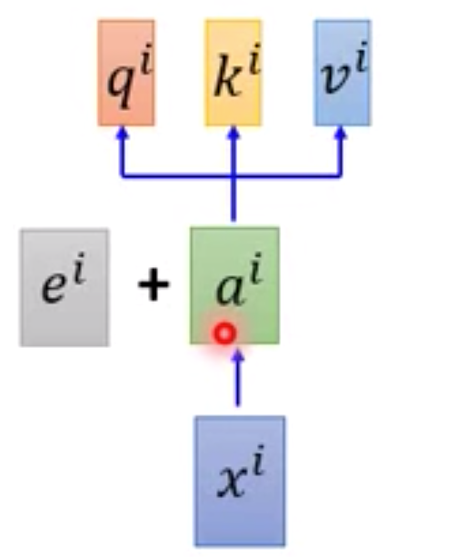
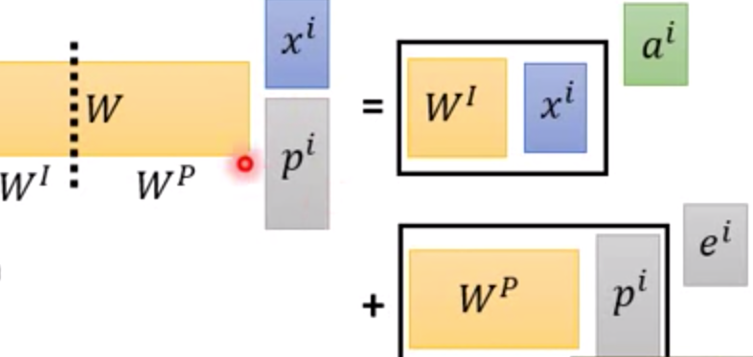
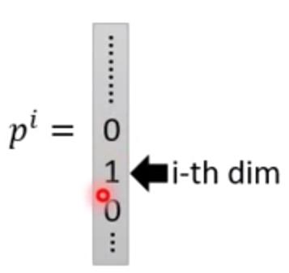
Position Encoding
No position information in self-attention
a打了b = b 打了a
2. Each position has a unique position vector e^{i}
(not learned from data)
3. Each x^{i} appends a one-hot vector p^{i}
Devlin, Jacob, et al. "Bert: Pre-training of deep bidirectional transformers for language understanding." arXiv preprint arXiv:1810.04805 (2018).

Slide 50
Word Embedding
embedding_lookup
https://github.com/the-Quert/iNLPfun/blob/master/BERT/modeling.py/ - L404-L435
Devlin, Jacob, et al. "Bert: Pre-training of deep bidirectional transformers for language understanding." arXiv preprint arXiv:1810.04805 (2018).

Slide 51
token_type Embedding
embedding_post_postprocessor
https://github.com/the-Quert/iNLPfun/blob/master/BERT/modeling.py/ - L480-L500
Devlin, Jacob, et al. "Bert: Pre-training of deep bidirectional transformers for language understanding." arXiv preprint arXiv:1810.04805 (2018).

Slide 52
Position Embedding
embedding_post_postprocessor
https://github.com/the-Quert/iNLPfun/blob/master/BERT/modeling.py/ - L502-L535
Devlin, Jacob, et al. "Bert: Pre-training of deep bidirectional transformers for language understanding." arXiv preprint arXiv:1810.04805 (2018).

Slide 53
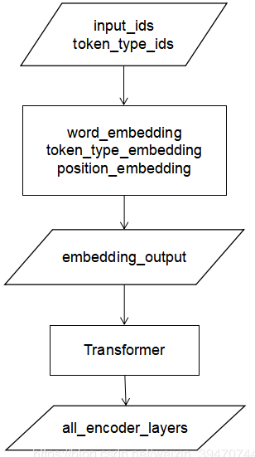
Transformer (Preparing for Attention)
2D to 3D shape of mask
https://github.com/the-Quert/iNLPfun/blob/master/BERT/modeling.py/ - L199-L222
Devlin, Jacob, et al. "Bert: Pre-training of deep bidirectional transformers for language understanding." arXiv preprint arXiv:1810.04805 (2018).

Slide 54
transformer_model
Residual Connection
https://github.com/the-Quert/iNLPfun/blob/master/BERT/modeling.py/ - L823-L848
Devlin, Jacob, et al. "Bert: Pre-training of deep bidirectional transformers for language understanding." arXiv preprint arXiv:1810.04805 (2018).

Slide 55
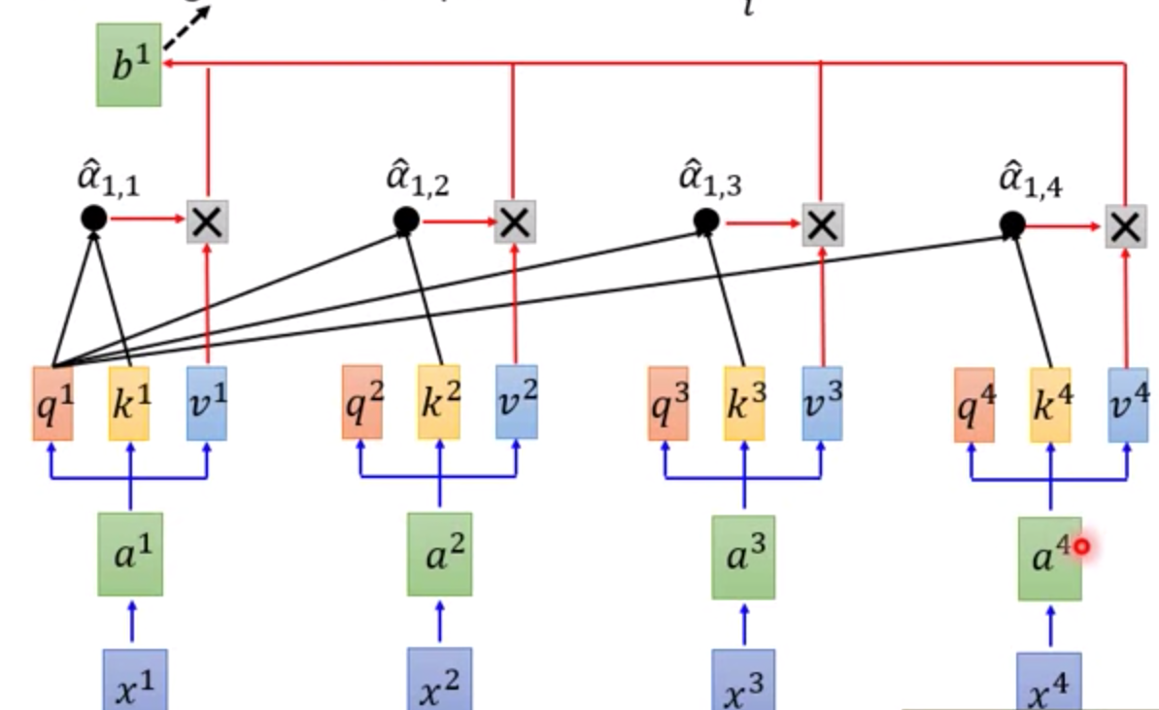
Build Q, K, V Matrix (Self-Attention)
transformer_model
https://github.com/the-Quert/iNLPfun/blob/master/BERT/modeling.py/ - L850-L872
attention_layer:
transpose_for_scores
Devlin, Jacob, et al. "Bert: Pre-training of deep bidirectional transformers for language understanding." arXiv preprint arXiv:1810.04805 (2018).

Slide 56
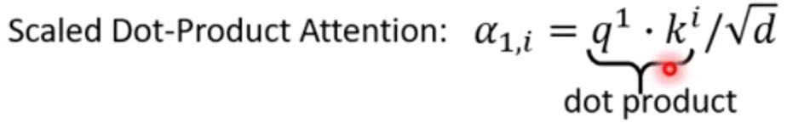
Scaled Dot-Product Attention
transformer_model
attention_layer:
transpose_for_scores
https://github.com/the-Quert/iNLPfun/blob/master/BERT/modeling.py/ - L646-L723\
Devlin, Jacob, et al. "Bert: Pre-training of deep bidirectional transformers for language understanding." arXiv preprint arXiv:1810.04805 (2018).

Slide 57
Preparing for softmax
transpose_for_scores
https://github.com/the-Quert/iNLPfun/blob/master/BERT/modeling.py/ - L726-L776
Devlin, Jacob, et al. "Bert: Pre-training of deep bidirectional transformers for language understanding." arXiv preprint arXiv:1810.04805 (2018).

Slide 58
Fully Connected Layer
(including Residual Connection)
https://github.com/the-Quert/iNLPfun/blob/master/BERT/run_classifier.py/ - L450
Devlin, Jacob, et al. "Bert: Pre-training of deep bidirectional transformers for language understanding." arXiv preprint arXiv:1810.04805 (2018).

Slide 59
Batch Normalization

Slide 60
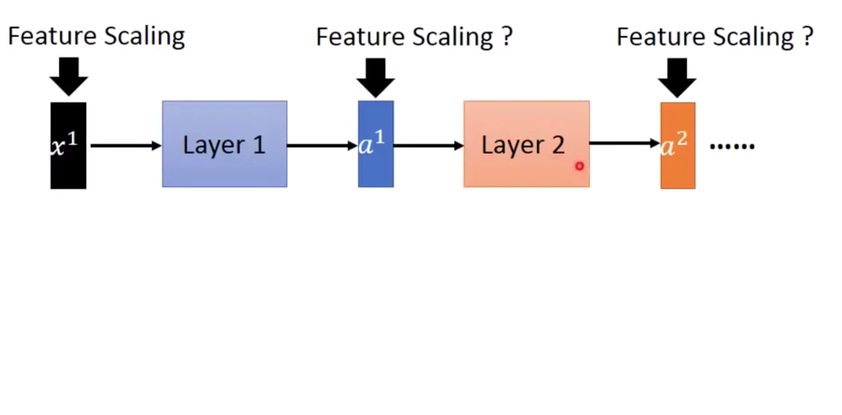
Hidden Layer

Slide 61
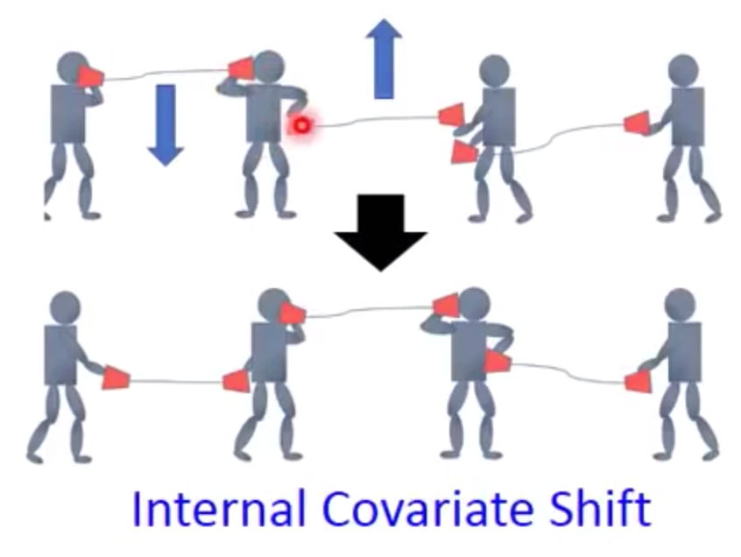
Internal Covariate Shift (ICS)
ICS refers to the change in the distribution of layer inputs caused by updates to the preceding layers. It is conjectured that such continual change negatively impacts training. The goal of BatchNorm was to reduce ICS and thus remedy this effect.

Slide 62
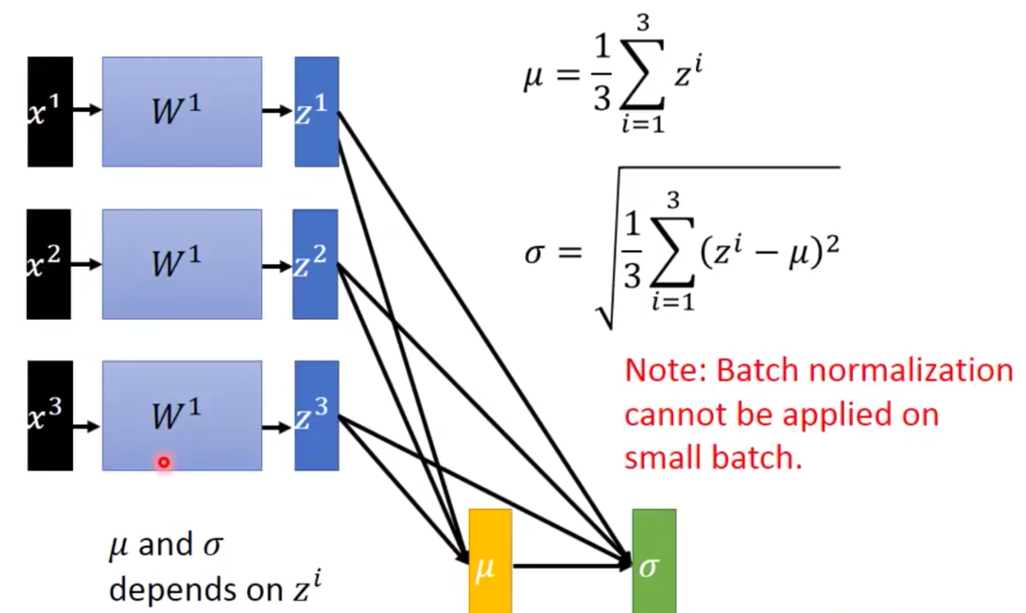
Batch Normalization

Slide 63
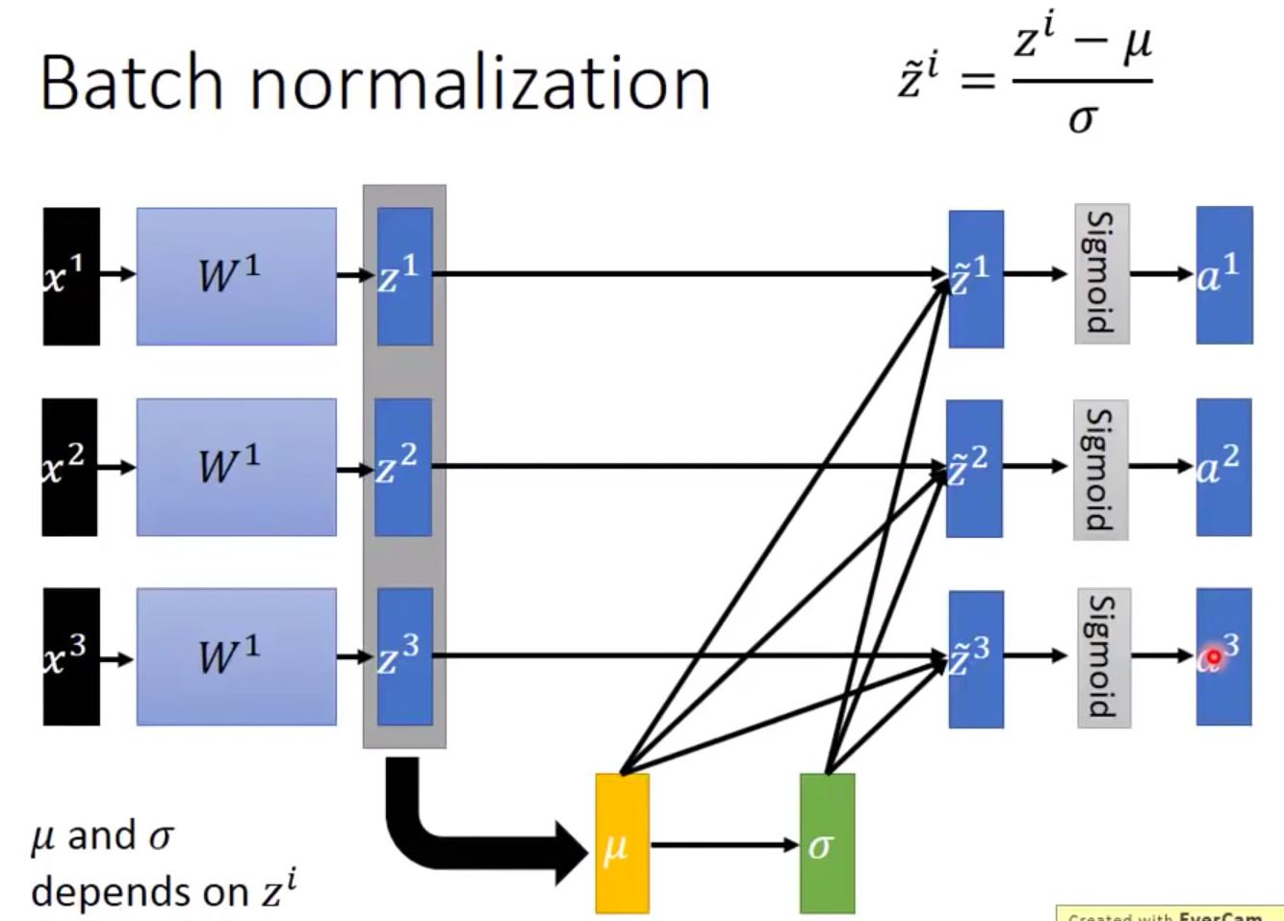
Batch Normalization
Saturation Region

Slide 64
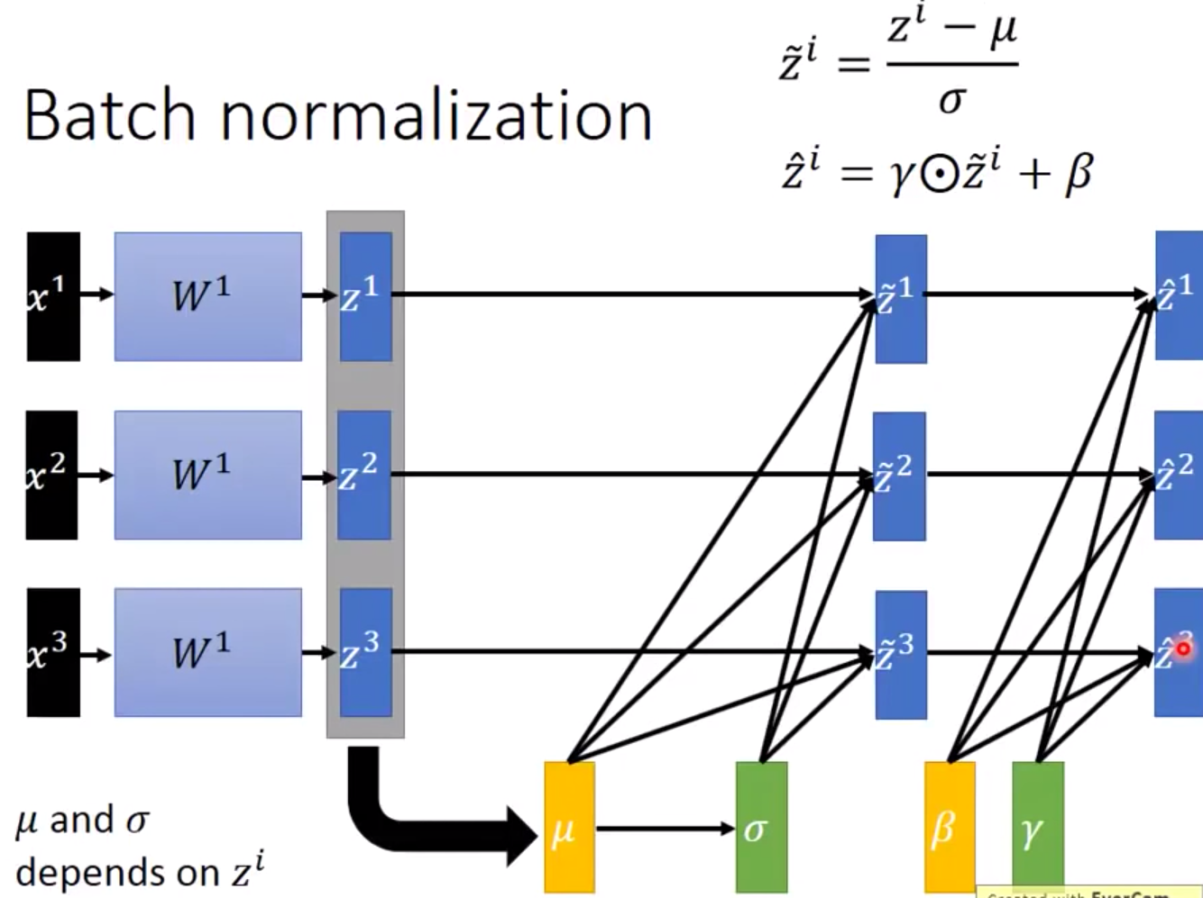
Batch Normalization

Slide 65
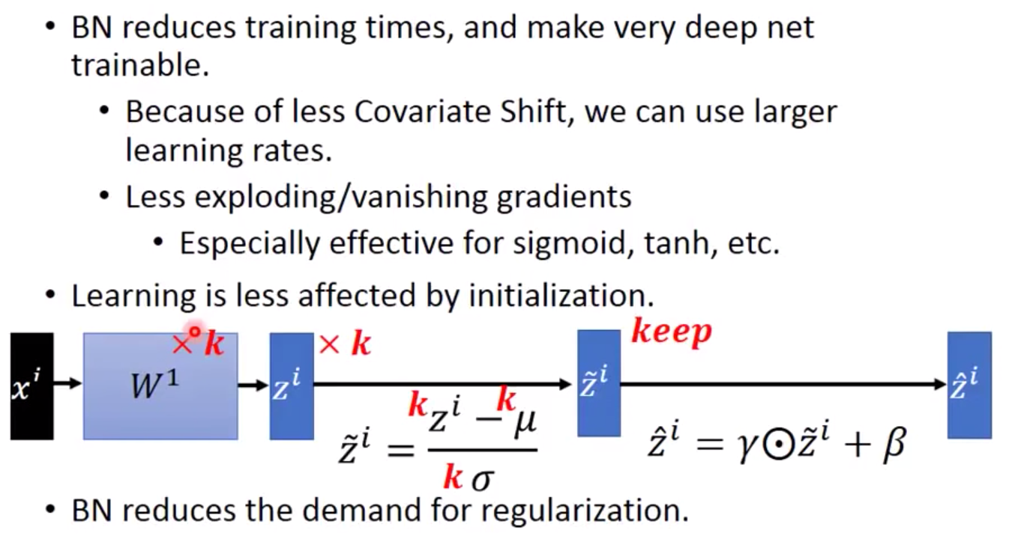
Batch Normalization
Benefit

Slide 66
Batch Normalization (Abstract)
Batch Normalization (BatchNorm) is a widely adopted technique that enables faster and more stable training of deep neural networks (DNNs).
Despite its pervasiveness, the exact reasons for BatchNorm’s effectiveness are still poorly understood. The popular belief is that this effectiveness stems from controlling the change of the layers’ input distributions during training to reduce the so-called “internal covariate shift”.

Slide 67
Batch Normalization (Abstract)
In this work, we demonstrate that such distributional stability of layer inputs has little to do with the success of BatchNorm.
Instead, we uncover a more fundamental impact of BatchNorm on the training process: it makes the optimization landscape significantly smoother. This smoothness induces a more predictive and stable behavior of the gradients, allowing for faster training.

Slide 68
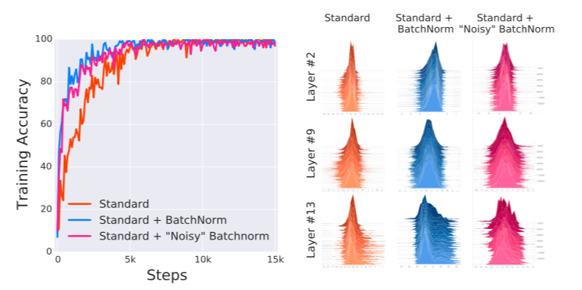
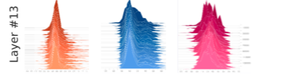
Batch Normalization + Covariate Shift ?

Slide 69
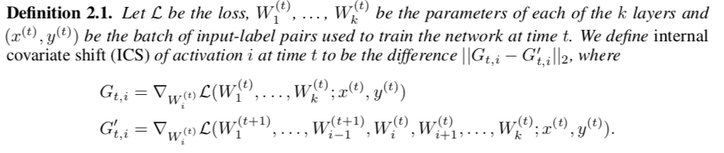
Batch Normalization & Covariate Shift
Clearly, these findings are hard to reconcile with the claim that the performance gain due to Batch-Norm seems from increased stability of layer input distributions.

Slide 70
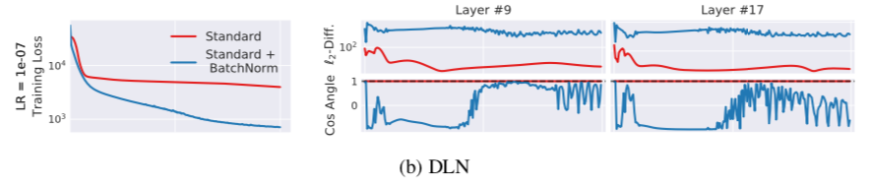
Batch Normalization works
Deep Linear Networks

Slide 71

Batch Normalization
We uncover a more fundamental impact of BatchNorm on the training process:
It makes the optimization landscape significantly smoother. This smoothness induces a more predictive and stable behavior of the gradients, allowing for faster training.

Slide 72
Batch Normalization
Indeed, we identify the key impact that BatchNorm has on the training process: it reparametrizes the underlying optimization problem to make its landscape significantly more smooth.
The first manifestation of this impact is improvement in the Lipschitzness of the loss function.

Slide 73
Batch Normalization
That is, the loss changes at a smaller rate and the magnitudes of the gradients are smaller too. There is, however, an even stronger effect at play. Namely, BatchNorm’s reparametrization makes gradients of the loss more Lipschitz too.

Slide 74
Batch Normalization
To understand why, recall that in a vanilla (non-BatchNorm), deep neural network, the loss function is not only non-convex but also tends to have a large number of “kinks”, flat regions, and sharp minima.
This makes gradient descent–based training algorithms unstable,
e.g., due to exploding or vanishing gradients, and thus highly sensitive to the choice of the learning rate and initialization.

Slide 75
input_mask
https://github.com/the-Quert/iNLPfun/blob/master/BERT/run_classifier.py/ - L446-L454

Slide 76
Word2Vec

Slide 77


One-hot encoding and WordNet
Problem with words as discrete symbols
WordNet – synonyms, hypernyms, hyponyms
Word meanings, relationships between words
^{Problems with WordNet}

Slide 78

Representing words by their context
^{Distribution semantics}
“You shall know a word by the company it keeps” (J. R. Firth 1957: 11)

Slide 79


Word meaning as a neural word vector - visualization
Word vectors (word embedding, word representation)
^{Distributed representation}
^{Two-dimensional view}

Slide 80




Word Embedding
Count based
Prediction based
Word2vec
W_{i-1} ~ W_{i-N}

Slide 81


Word Embedding - Prediction based
Make W_{i} equal to W_{j}, given W_{i} and W_{j} the same initialization

Slide 82


Word2vec
Continuous Bag of Words (CBOW)
Skip-gram (SG)

Slide 83

Word2vec
Word2vec (Mikolov et al. 2013) is a framework for learning word vectors.

Slide 84


Word2vec

Slide 85


Word2vec objective function
^{Objective function}

Slide 86


Word2vec objective function
^{Objective function}
Calculate each word with two vectors

Slide 87


To train the model: Compute all vector gradients

Slide 88

Model Details

Slide 89

Model Details
Reverse SG -> CBOW

Slide 90
Word2vec
Continuous Bag of Words (CBOW)
Skip-gram (SG)

Slide 91
Training Model
^{Negative Sampling}
^{Sub-sampling}

Slide 92
Model Details (Negative Sampling)
Word pairs -> Words
Phrase detection is covered in the “Learning Phrases” section of their paper.
They shared their implementation in word2phrase.–I’ve shared a commented
(but otherwise unaltered) copy of this code here.

Slide 93
Model Details (Negative Sampling)
Each pass of their tool only looks at combinations of 2 words, but you can run it multiple times to get longer phrases.
So, the first pass will pick up the phrase “New_York”, and then running it again will pick up “New_York_City” as a combination of “New_York” and “City”.

Slide 94
Model Details (Sub-Sampling)

Slide 95
Model Details (Sub-Sampling)
For each word we encounter in our training text, there is a chance that we will effectively delete it from the text. The probability that we cut the word is related to the word’s frequency.
If we have a window size of 10, and we remove a specific instance of “the” from our text:
As we train on the remaining words, “the” will not appear in any of their context windows.
We’ll have 10 fewer training samples where “the” is the input word.

Slide 96


Model Details (Sub-Sampling)
Sampling Rate

Slide 97
Model Details (Negative Sampling)
Negative sampling addresses this by having each training sample only modify a small percentage of the weights, rather than all of them. Here’s how it works.
When training the network on the word pair (“fox”, “quick”), recall that the “label” or “correct output” of the network is a one-hot vector.
That is, for the output neuron corresponding to “quick” to output a 1, and for all of the other thousands of output neurons to output a 0.

Slide 98


Model Details (Negative Sampling)
The authors state in their paper that they tried a number of variations on this equation, and the one which performed best was to raise the word counts to the 3/4 power:

Slide 99
Model Details (Negative Sampling)
With negative sampling, we are instead going to randomly select just a small number of “negative” words (let’s say 5) to update the weights for. (In this context, a “negative” word is one for which we want the network to output a 0 for). We will also still update the weights for our “positive” word (which is the word “quick” in our current example).
Recall that the output layer of our model has a weight matrix that’s
300 x 10,000. That’s a total of 6 output neurons, and 1,800 weight values total. That’s only 0.06% of the 3M weights in the output layer.

Slide 100
Transformer

Slide 101


RNN
CNN

Slide 102





Self-attention
Word-Embedding
Attention

Slide 103


Self-attention

Slide 104

Self-attention

Slide 105

Self-attention

Slide 106



Self attention with Parallels Computing

Slide 107

Self-attention and Padding Mask

Slide 108
Position Encoding
No position information in self-attention
a打了b = b 打了a
2. Each position has a unique position vector e^{i}
(not learned from data)
3. Each x^{i} appends a one-hot vector p^{i}

Slide 109

Multi-head Self-attention

Slide 110
Architecture of Transformer

Slide 111


Self-Attention Visualization

Slide 112
Self-Attention Visualization

Slide 113

Multi-Head Attention Visualization

Slide 114
Demo: Word2Vec

Slide 115
Word2vec (Implementation)
^{Wiki data preprocessing}
https://colab.research.google.com/github/the-Quert/inlpfun/blob/master/word2vec/word2vec.ipynb
https://github.com/the-Quert/inlpfun/blob/master/word2vec/wiki_to_txt.py

Slide 116
Word2vec (Implementation)
Segmentation (Stopwords, CN2TW)
https://github.com/the-Quert/inlpfun/blob/master/word2vec/segmentaion.py

Slide 117
Word2vec (Implementation)
^{View Chinese Stopwords}
https://github.com/the-Quert/inlpfun/blob/master/word2vec/stopwords.txt

Slide 118
Word2vec (Implementation)
^{Training and task processing}
https://github.com/the-Quert/inlpfun/blob/master/word2vec/train.py
https://github.com/the-Quert/inlpfun/blob/master/word2vec/main.py

Slide 119
Recurrent Neural Network
(RNN)

Slide 120

Feedforward Neural Network Model

Slide 121


Simple-RNN Model

Slide 122


Simple-RNN Model

Slide 123



Simple-RNN Model

Slide 124

Simple-RNN Model Categories

Slide 125

Bidirectional Simple-RNN
Example: Bidirectional LSTM -> Seq2Seq

Slide 126
Long Short-term Memory
(LSTM)

Slide 127

LSTM Model
The vanishing gradient problem of RNN is resolved.

Slide 128




LSTM Model
Input
Forget
Output

Slide 129

LSTM - Example

Slide 130

LSTM - Example

Slide 131

LSTM - Example
Input vectors between RNN and LSTM

Slide 132

LSTM

Slide 133

LSTM

Slide 134

Multi-Layer LSTM

Slide 135
BERT and LSTM
LSTM
One weakness of the LSTM, and of many contemporary RNNs,
is capacity.

Slide 136

BERT and RNN (LSTM)
BERT
Transformer which removes the LSTM, and only uses attention to transmit information across time.

Slide 137
Demo: Sentiment Analysis
using BERT

Slide 138
Bidirectional Encoder Representation from Transformers (BERT)
Pre-training
Masked Language Model (MLM)
Devlin, Jacob, et al. "Bert: Pre-training of deep bidirectional transformers for language understanding." arXiv preprint arXiv:1810.04805 (2018).

Slide 139
Bidirectional Encoder Representation from Transformers (BERT)
Pre-training
2. Next Sentence Prediction (NSP)
[SEP]: 句子間的分界
[CLS]: 放在句子開頭token, 告訴Encoder要做 Classification
Devlin, Jacob, et al. "Bert: Pre-training of deep bidirectional transformers for language understanding." arXiv preprint arXiv:1810.04805 (2018).

Slide 140
Demo: Sentiment Analysis on IMDb using BERT
➔ A new method of unsupervised pre-training language representations,
which extracts features from raw text input.
➔ A classifier can then be stacked on top of the representation and perform
supervised fine-tuning on our sentiment task. (Transfer Learning)
Devlin, Jacob, et al. "Bert: Pre-training of deep bidirectional transformers for language understanding." arXiv preprint arXiv:1810.04805 (2018).

Slide 141
Demo: Sentiment Analysis on IMDb using BERT
Large Movie Review Dataset (IMDb) from Stanford
50,000 highly polar, preprocessed movie reviews (as of 2011)
https://colab.research.google.com/github/the-Quert/inlpfun/blob/master/Lab/Demo/BERT/bert_demo.ipynb
Devlin, Jacob, et al. "Bert: Pre-training of deep bidirectional transformers for language understanding." arXiv preprint arXiv:1810.04805 (2018).

Slide 142
Demo: Sentiment Analysis
using LSTM

Slide 143


Demo: Sentiment Analysis using LSTM
RNN
The hidden state vector at the final time step is fed into a binary softmax classifier where it is multiplied by another weight matrix and put through a softmax function that outputs values between 0 and 1.

Slide 144
Demo: Sentiment Analysis using LSTM
LSTM
(with 4 fully connected layers )
Input (with 2 FC)
Forget (with 1 FC)
Output (with 1 FC)

Slide 145
Demo: Sentiment Analysis using LSTM
Word Embedding: Word2Vec and GloVe
The GloVe matrix will contain 400,000 word vectors, each with a dimensionality of 50.

Slide 146

Demo: Sentiment Analysis using LSTM
Index and Embedding Matrix
Output: 10 X 50

Slide 147
Demo: Sentiment Analysis using LSTM
Large Movie Review Dataset (IMDb) from Stanford
50,000 highly polar, preprocessed movie reviews (as of 2011)
https://colab.research.google.com/github/the-Quert/inlpfun/blob/master/Lab/Demo/LSTM/lstm_demo.ipynb

Slide 148
Demo: Sentiment Analysis using LSTM
Large Movie Review Dataset (IMDb) from Stanford
50,000 highly polar, preprocessed movie reviews (as of 2011)
Accuracy
BERT: 85.82866
LSTM: 50.891666802763936

Slide 149
GloVe: Global Vectors for
Word Representation

Slide 150
Seq2Seq

Slide 151
Demo: Sentiment Analysis
using Seq2Seq

Slide 152
A Lite BERT
(ALBERT)

Slide 153
Demo: Sentiment Analysis
using ALBERT

Slide 154
BART

Slide 155
Demo: Sentiment Analysis
using BART

Slide 156
XLNet

Slide 157
Demo: Sentiment Analysis
using XLNet

Slide 158
Source Code (BERT):
Modeling
Devlin, Jacob, et al. "Bert: Pre-training of deep bidirectional transformers for language understanding." arXiv:1810.04805 (2018).

